Slide 1

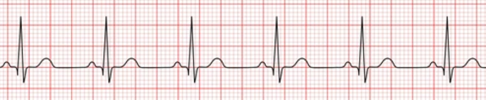
Part 2: Heart rate estimation

Slide 2
INTRODUCTION
Electrocardiogram (ECG) signals are heart signals (electrical activity of the heart) routinely used to monitor heart health. Heart rate (HR) is an important parameter used for health assessment. The ECG is a quasi-periodic signal, and the HR typically varies over time based on the activity involved. Often, these signals get corrupted during the measurement process.

Slide 3
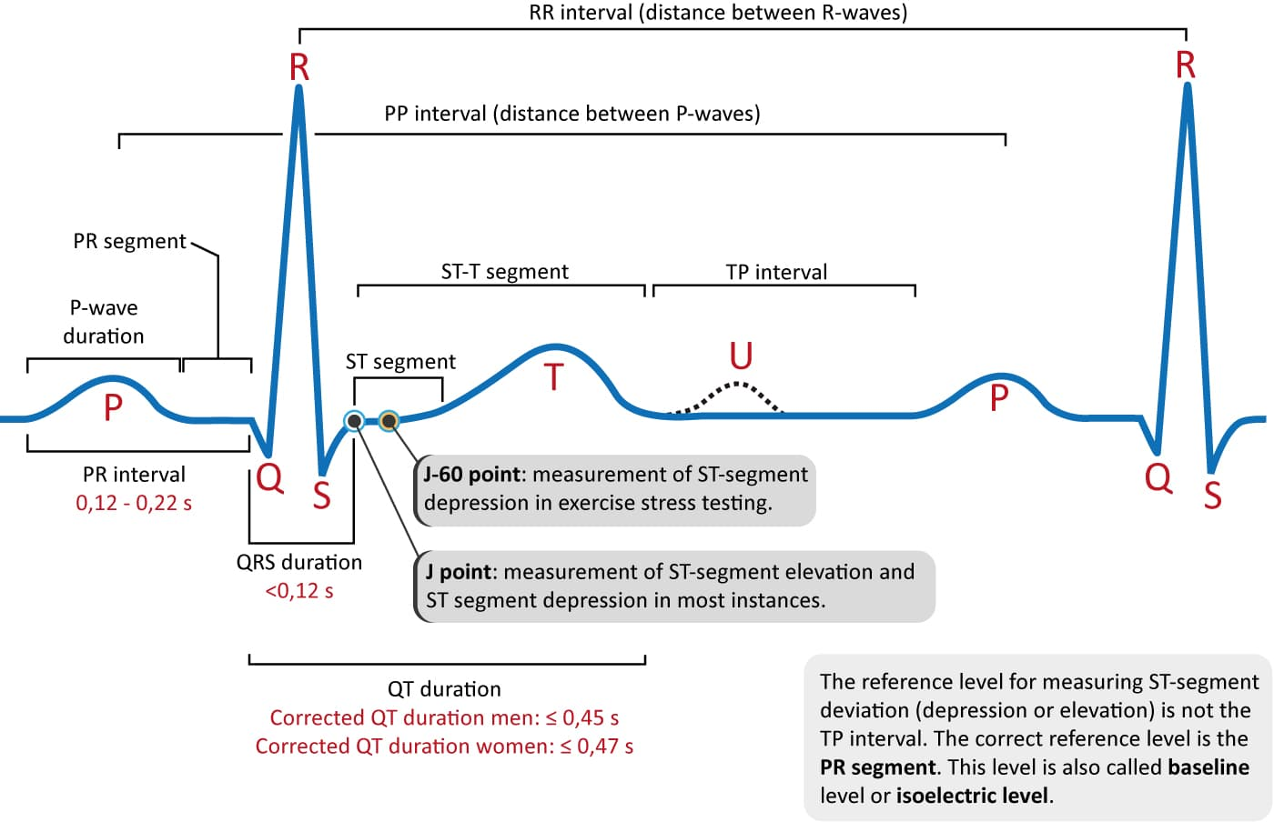
ECG INTERPRETATION
STEP 1 :
Use an ECG device to record the signal. Ensure the sampling rate is high enough to capture the signal's features.
STEP 2 :
Apply filters to remove unwanted frequencies(noise).
STEP 3 :
Detect R-Peaks.
STEP 4 :
Measure the time difference between consecutive R-peaks.
STEP 5 :
Compute the heart rate.

Slide 4
TASK-1
We are given signal E1 which is a noise free ECG signal. The sampling rate is 128 samples/second. Our objective for Task 1 is to find and plot the HR as function of time, and perform the estimation per minute.

Slide 5
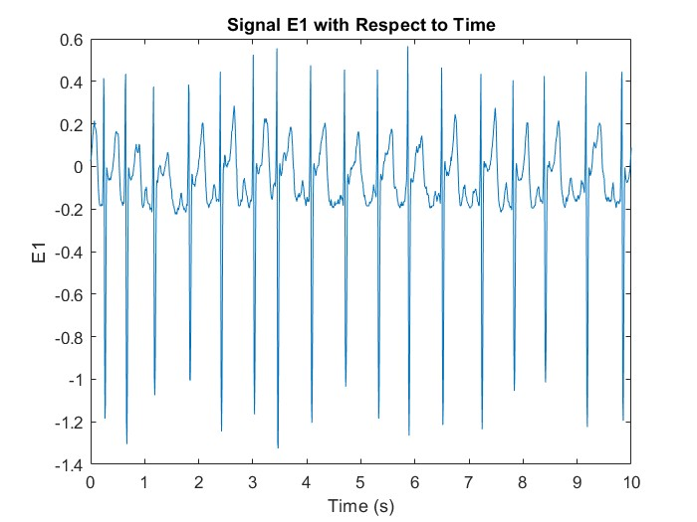
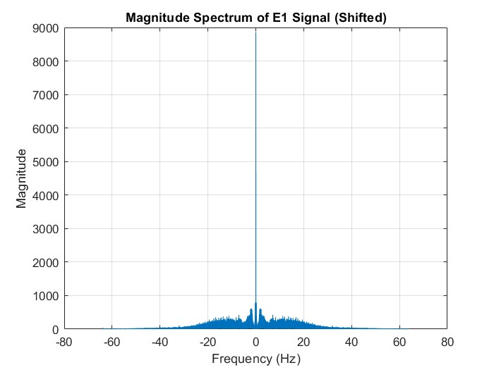
ORIGINAL SIGNAL

Slide 6
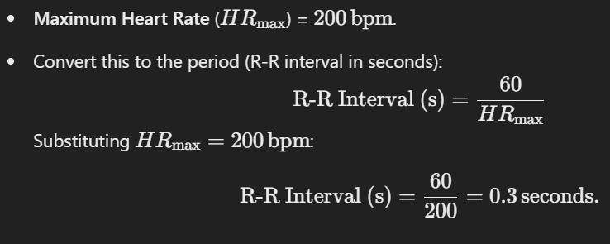
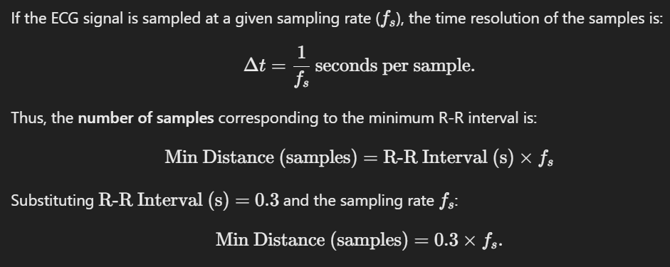
SETTING PARAMETERS
Sampling Rate : 128 Hz
Threshold Value :
The threshold value has been set to 0.17 on observing the given ECG graph.
Minimum Distance between peaks :
The minimum distance between the R-R peaks has been set to 0.3 * (sampling rate) on doing the following calculations -

Slide 7
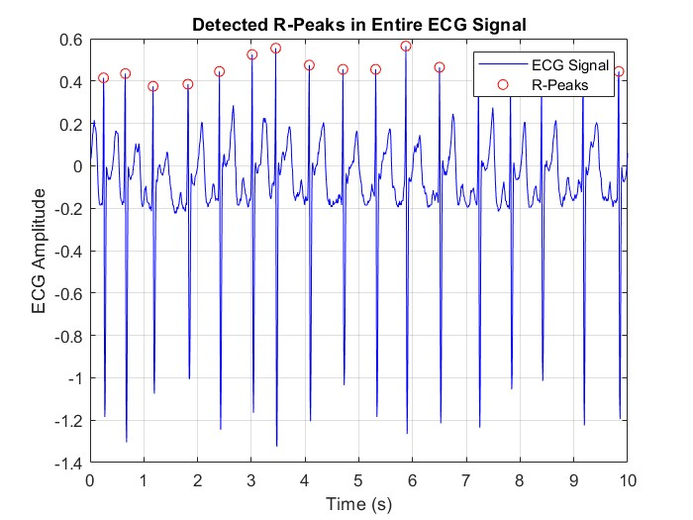
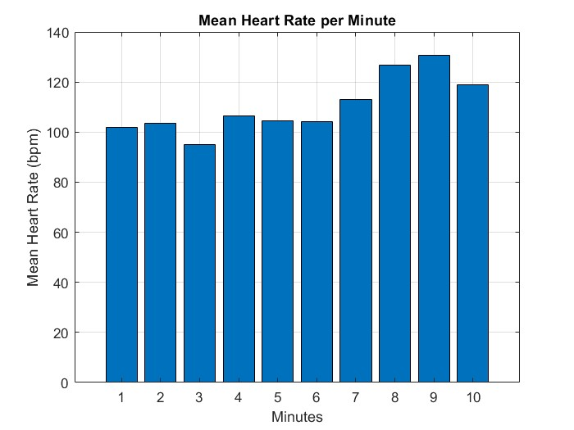
RESULTS
The average Heart Rate detected is 108.72bpm

Slide 8
TASK-2
We are given signals E2 and E3 which are noisy ECG signals. The sampling rate is 128 samples/second. Our objective for Task 2 is to perform appropriate noise removal and find and plot the HR as function of time, and perform the estimation per minute.

Slide 9
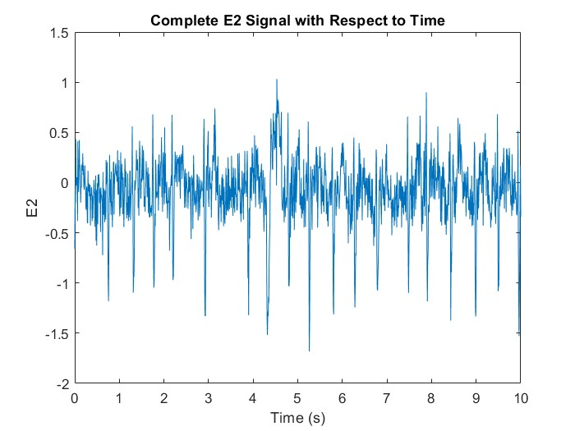
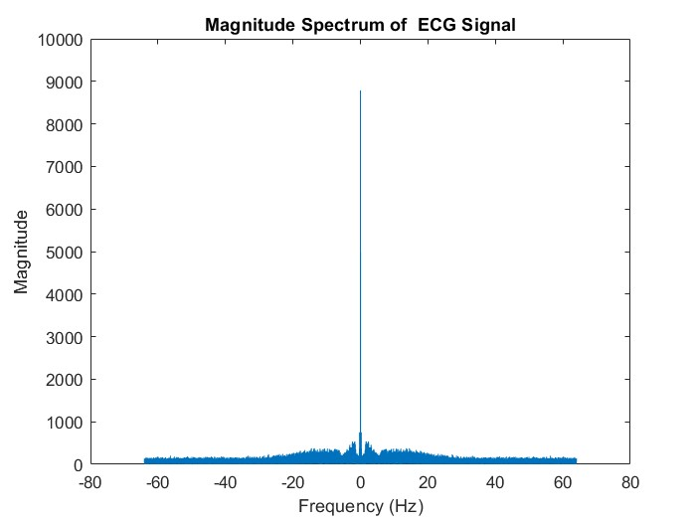
ORIGINAL SIGNAL E2

Slide 10
SIGNAL E2
As we can see the plots, we can observe that E2 has a lot of noise.
To eliminate noise, we have to apply filters. If we compare magnitude spectrum of noiseless E1 and noisy E2 :
We can clearly observe that we need to apply a low pass filter to eliminate frequencies above 45Hz.

Slide 11
SIGNAL E2
There is a problem, if we are considering frequencies 0Hz - 45Hz, we are still getting noisy time domain signal, and we are having difficulty in setting a threshold because non R peaks might be detected.
So, we have considered frequencies 5Hz - 45Hz using band pass filter. The time domain signal is still noisy but we are able to set a clear threshold.
This change reduces baseline wander and other low-frequency noise, making it easier to distinguish between true R peaks and noise.
Baseline wander is a low-frequency oscillation in signals, caused by breathing, electrode motion, or other artifacts, distorting analysis. Eliminating this can help us significantly differentiate between R peaks and noise.

Slide 12
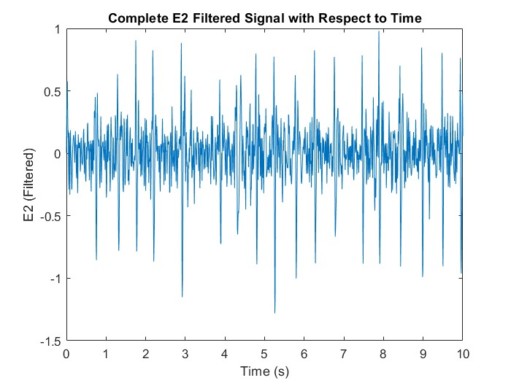
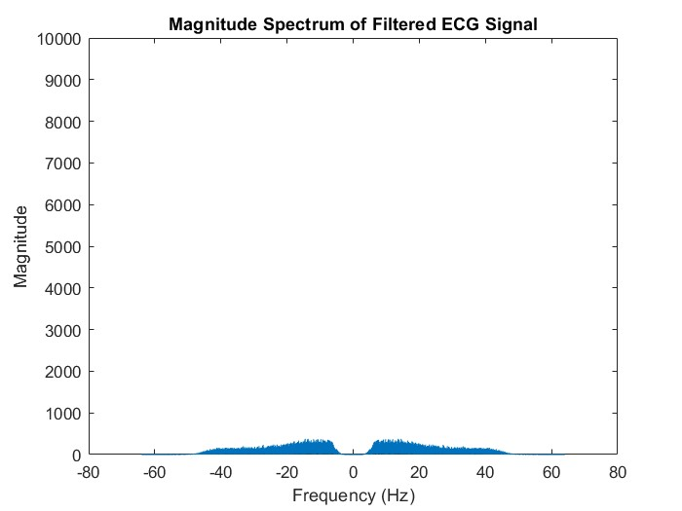
FILTERED SIGNAL
Threshold Value :
The threshold value has been set to 0.38 on observing the given ECG graph.

Slide 13
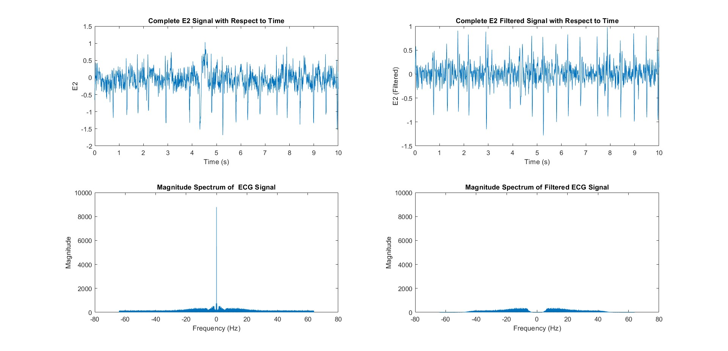
COMPARING BEFORE AND AFTER FILTERING PLOTS

Slide 14
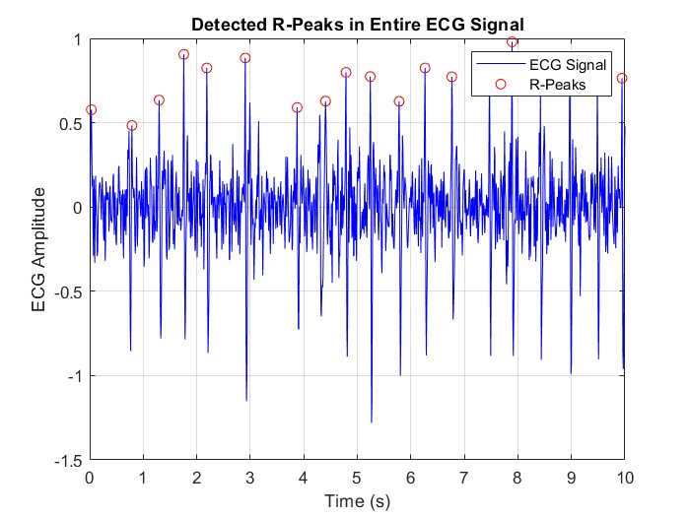
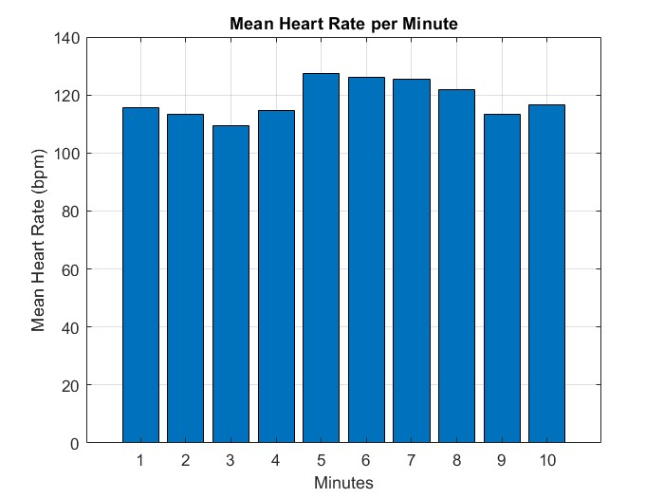
RESULTS
The average Heart Rate detected is 114.10bpm

Slide 15
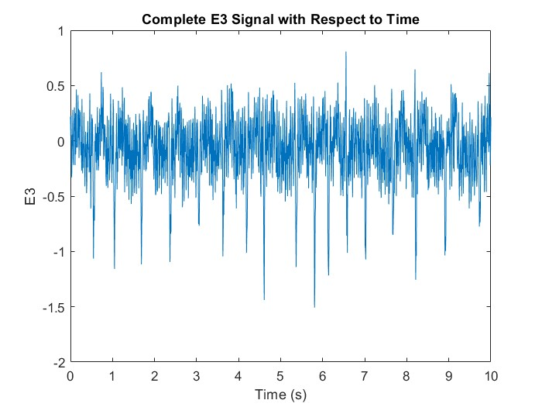
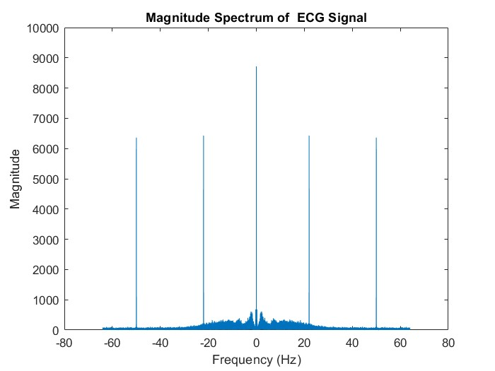
ORIGINAL SIGNAL E3

Slide 16
SIGNAL E3
As we can see the plots, we can observe that E3 has a lot of noise.
To eliminate noise, we have to apply filters. If we compare magnitude spectrum of noiseless E1 and noisy E3 :

Slide 17
SIGNAL E3
First, we need to apply a notch filter which does not pass the abnormal noisy peaks we are getting at 22Hz and 50Hz.
Then, we will again apply a band pass filter which passes 5Hz – 45Hz.

Slide 18
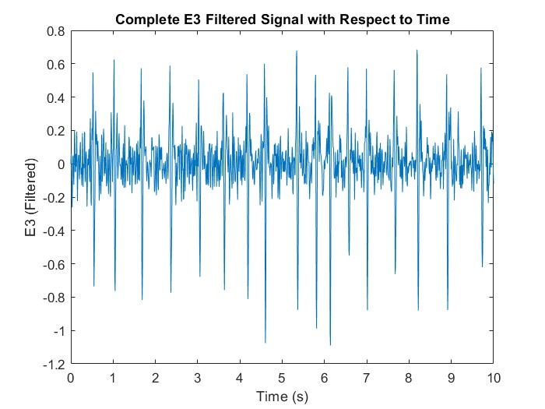
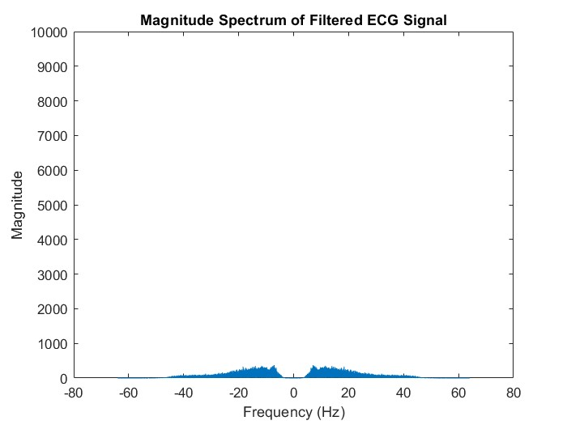
FILTERED SIGNAL
Threshold Value :
The threshold value has been set to 0.38 on observing the given ECG graph.

Slide 19
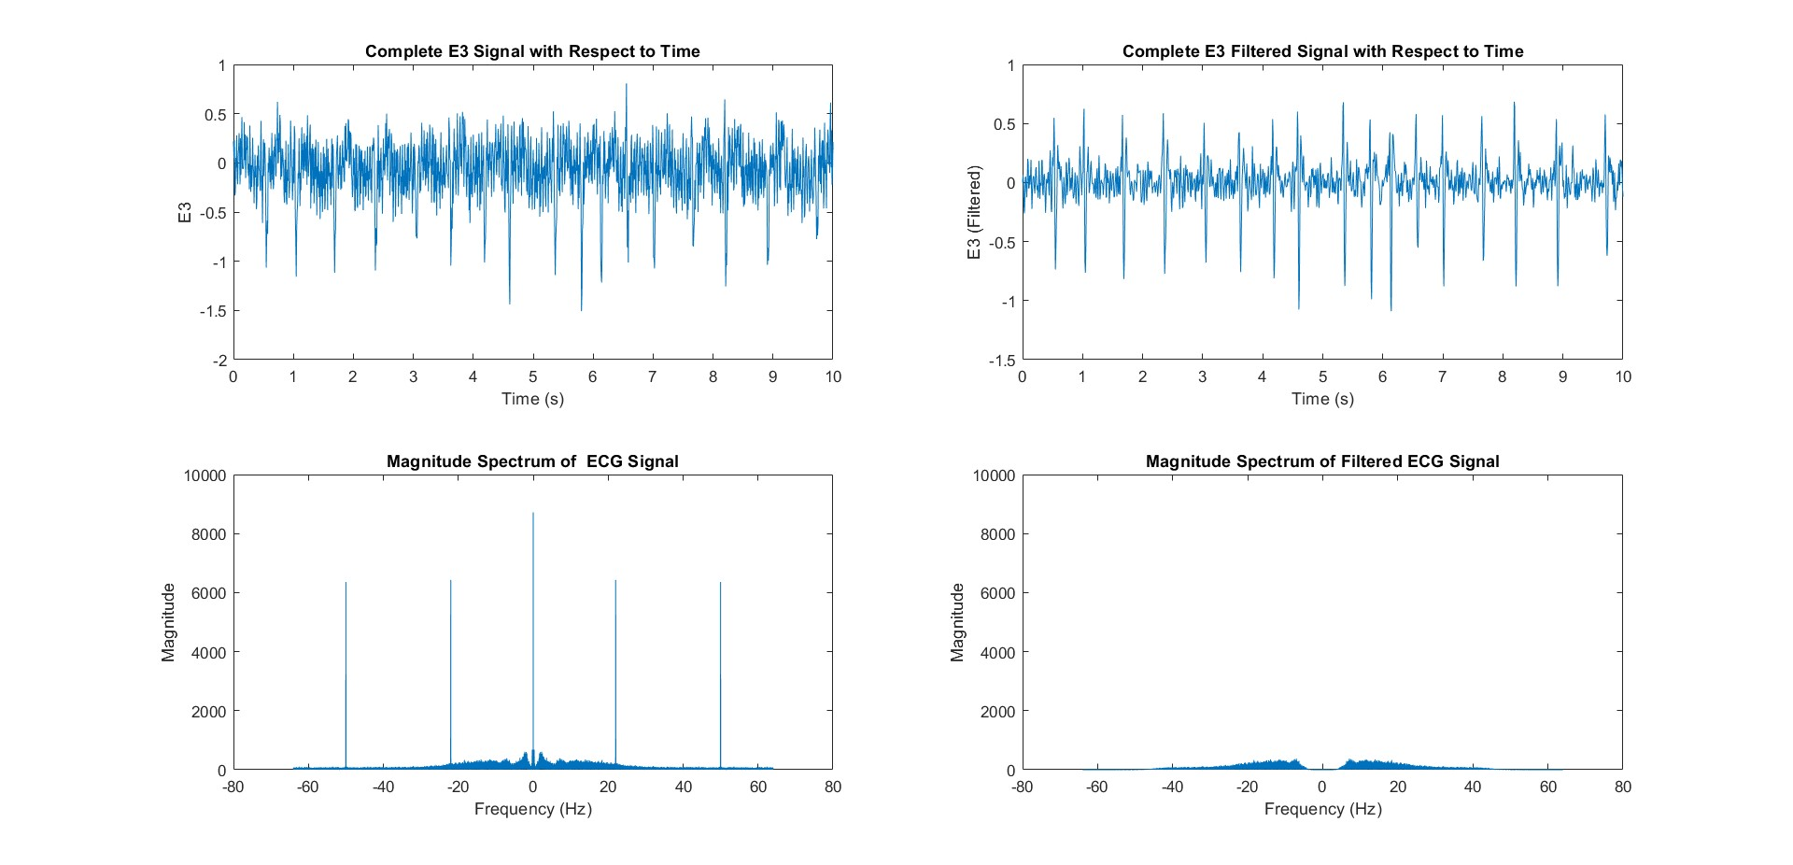
COMPARING BEFORE AND AFTER FILTERING PLOTS

Slide 20
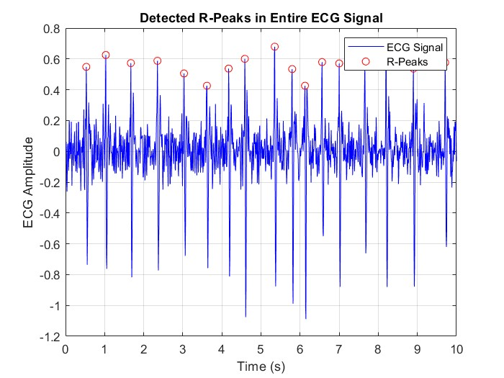
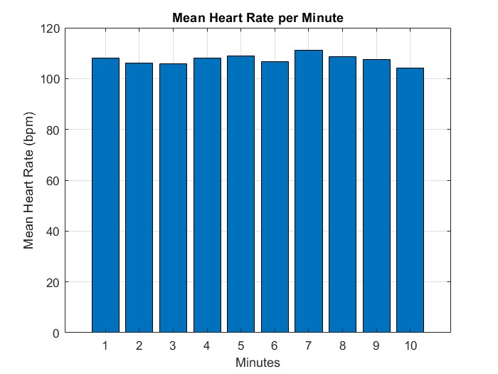
RESULTS
The average Heart Rate detected is 110.73bpm

Slide 21
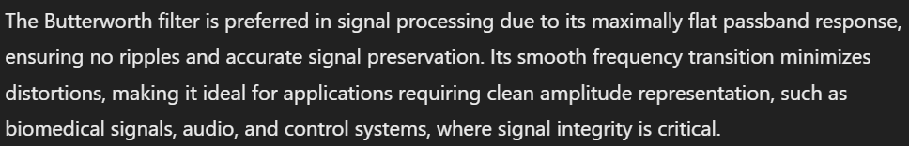
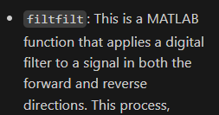
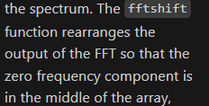
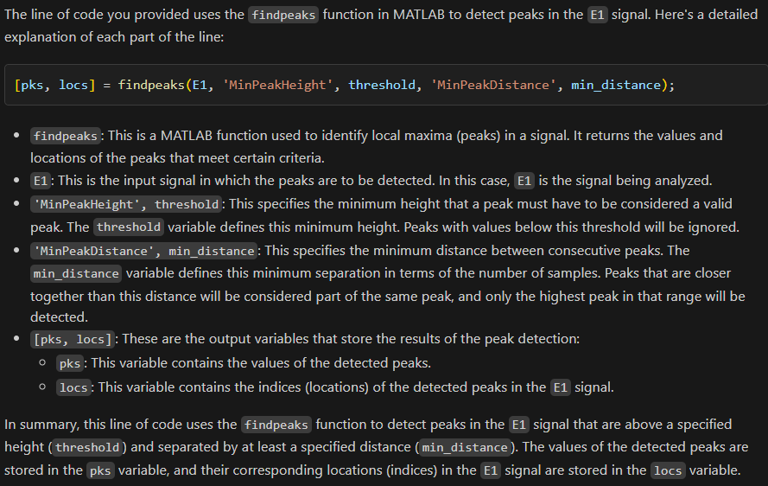
QUESTIONS :
We could have also done noise removal in E1 because signal given is noisy(therefore we can set a very evident threshold).

